Slide 1
Images from the dataset and a YOLOv8 model were loaded, and initial detection was performed
to establish baseline confidence scores for cars.
An adversarial patch was trained over 2000 iterations using an optimization loop designed to
minimize the detection confidence for the car class.
The code selected only the images where a car was successfully detected and pasted the trained
adversarial patch inside the detected bounding boxes.
Object detection was performed again on these modified images to verify the effect of the patch.

Slide 2
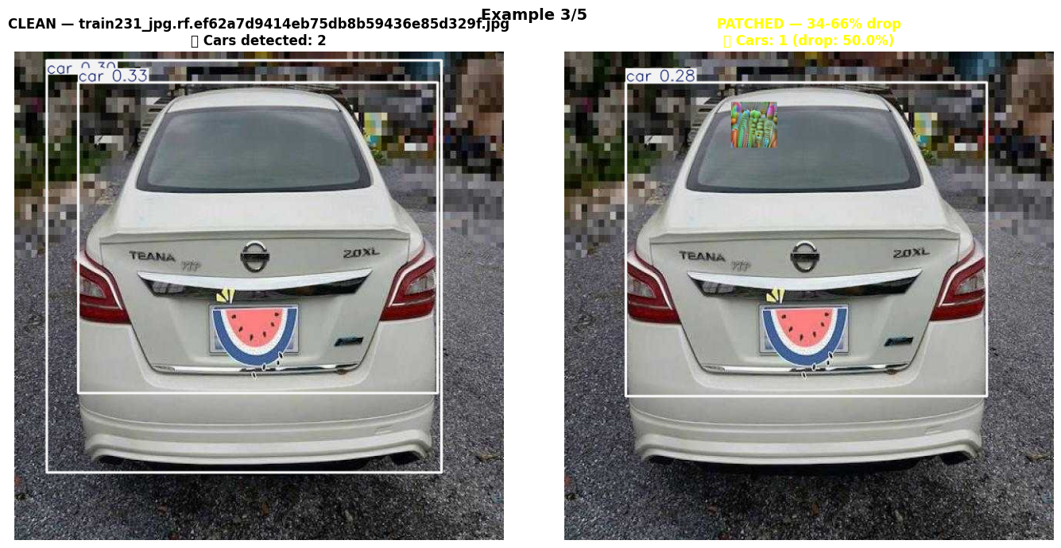

Slide 3
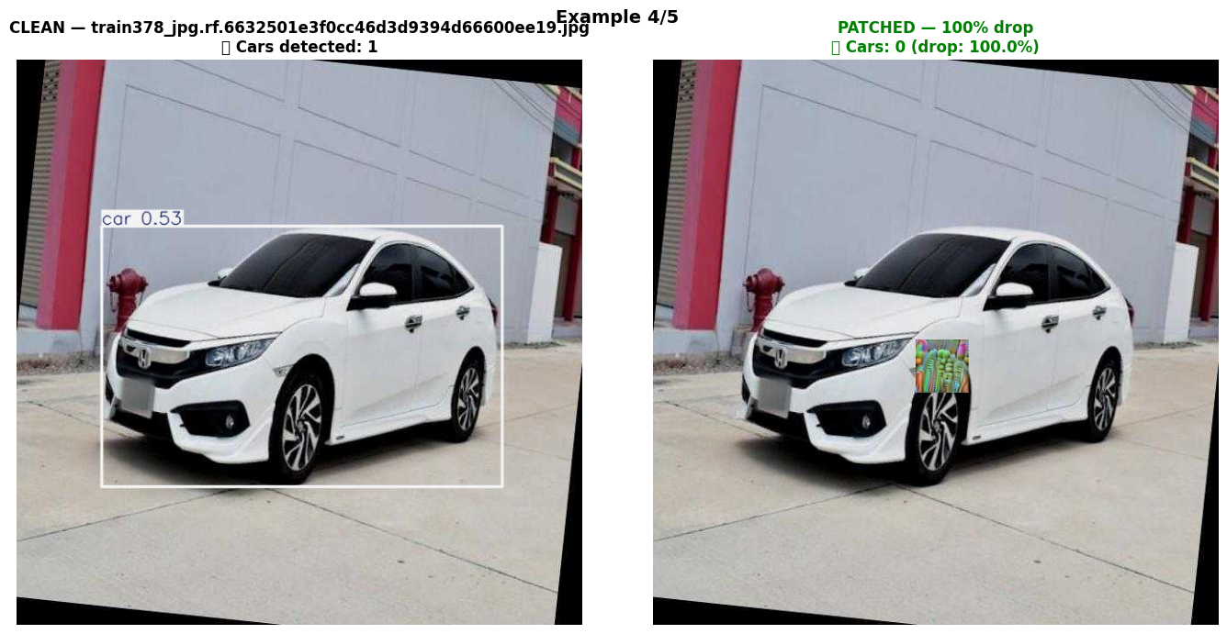

Slide 4
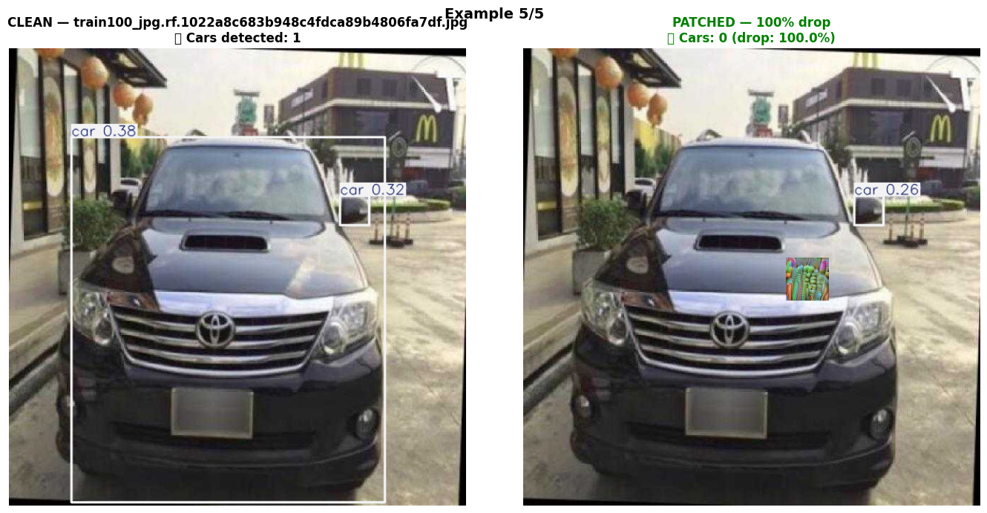

Slide 5
Considering only the patched images which were able to fool YOLOV8 as the dataset and tried segmenting them using YOLOV11

Slide 6
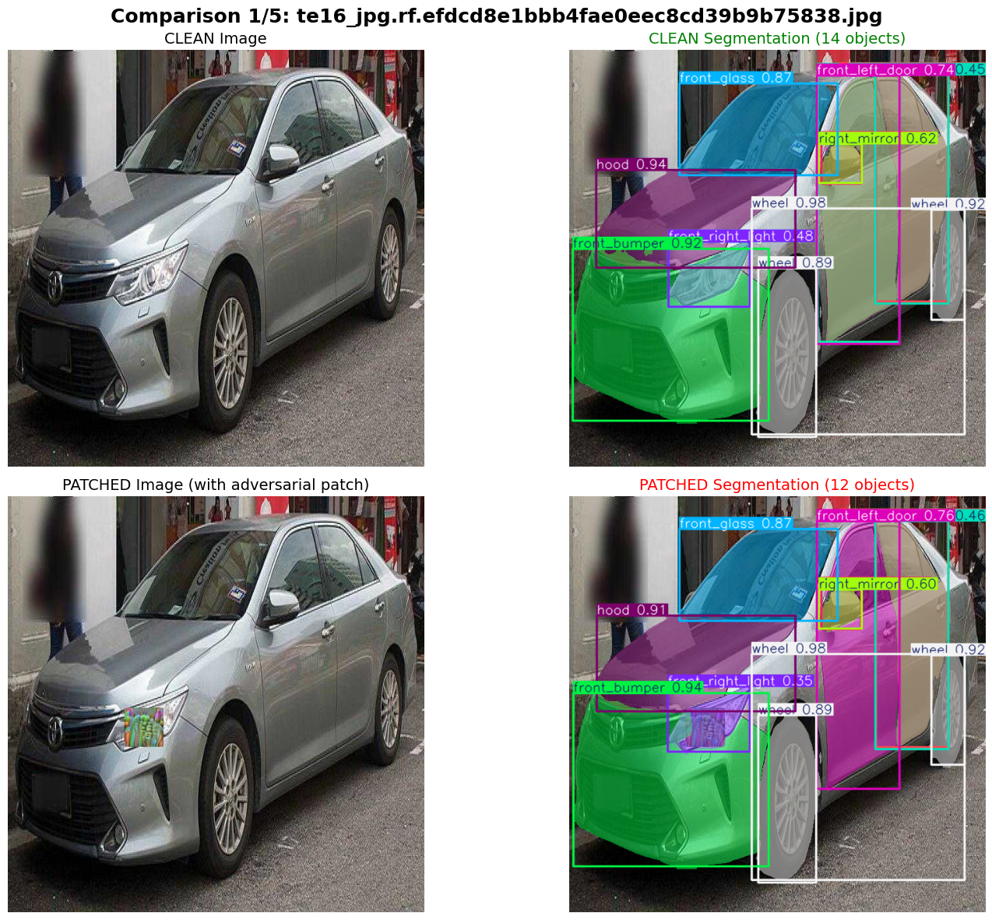
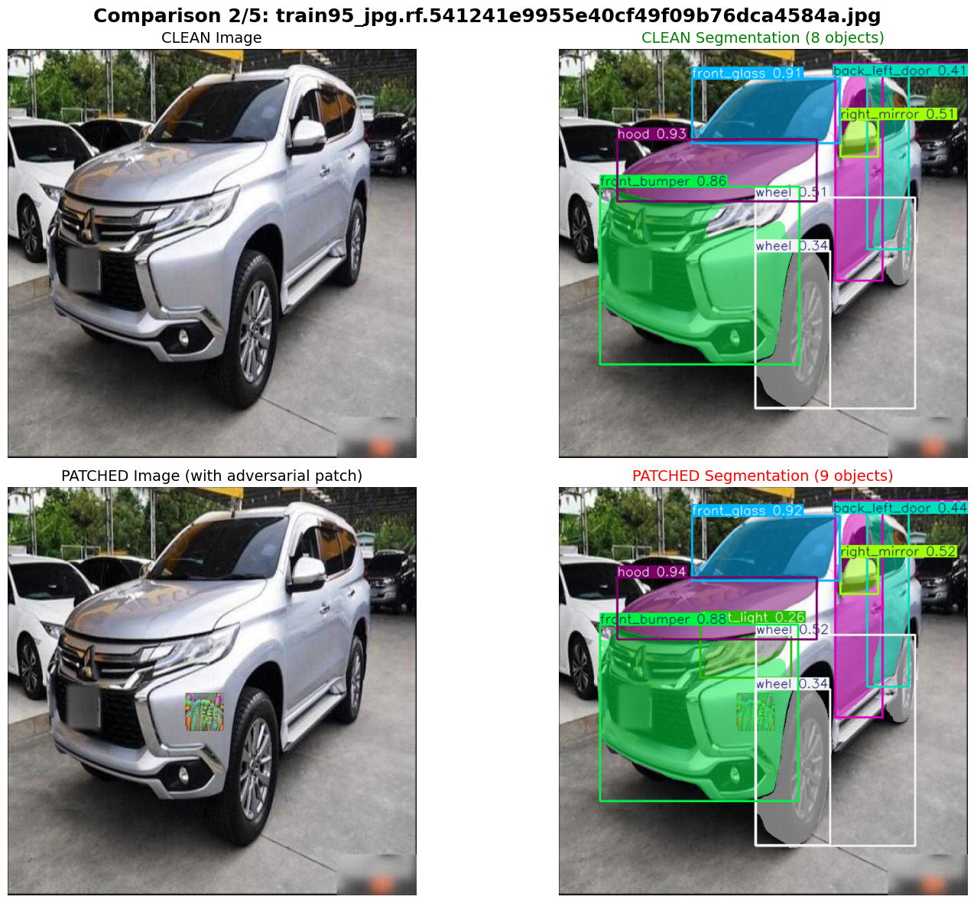

Slide 7
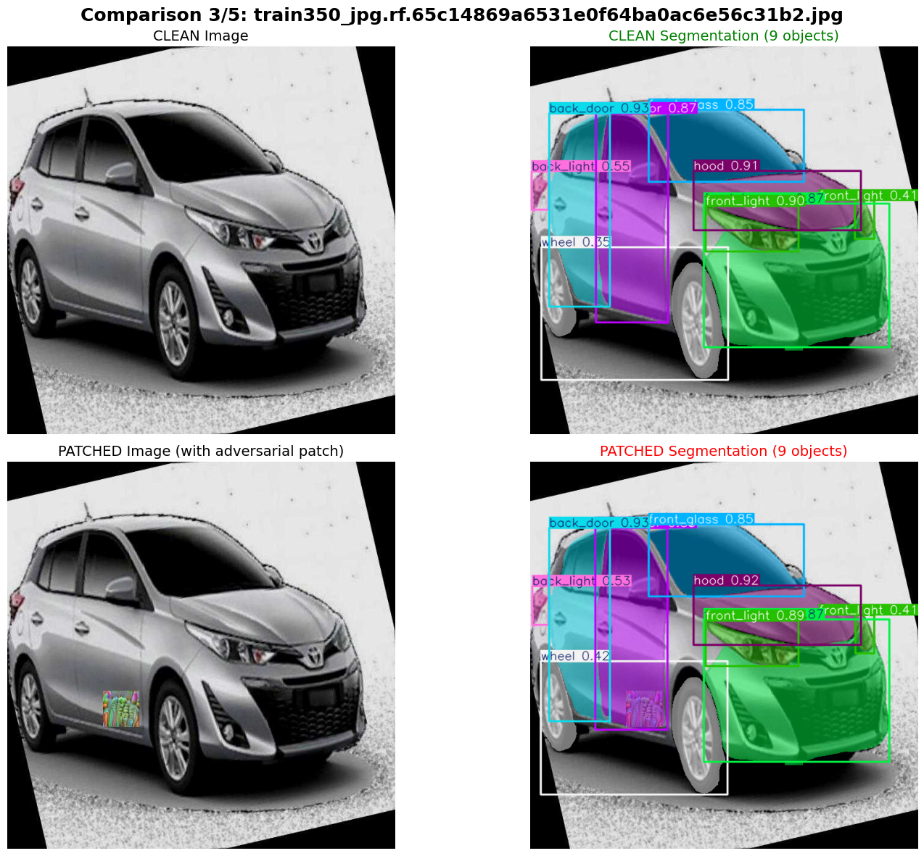
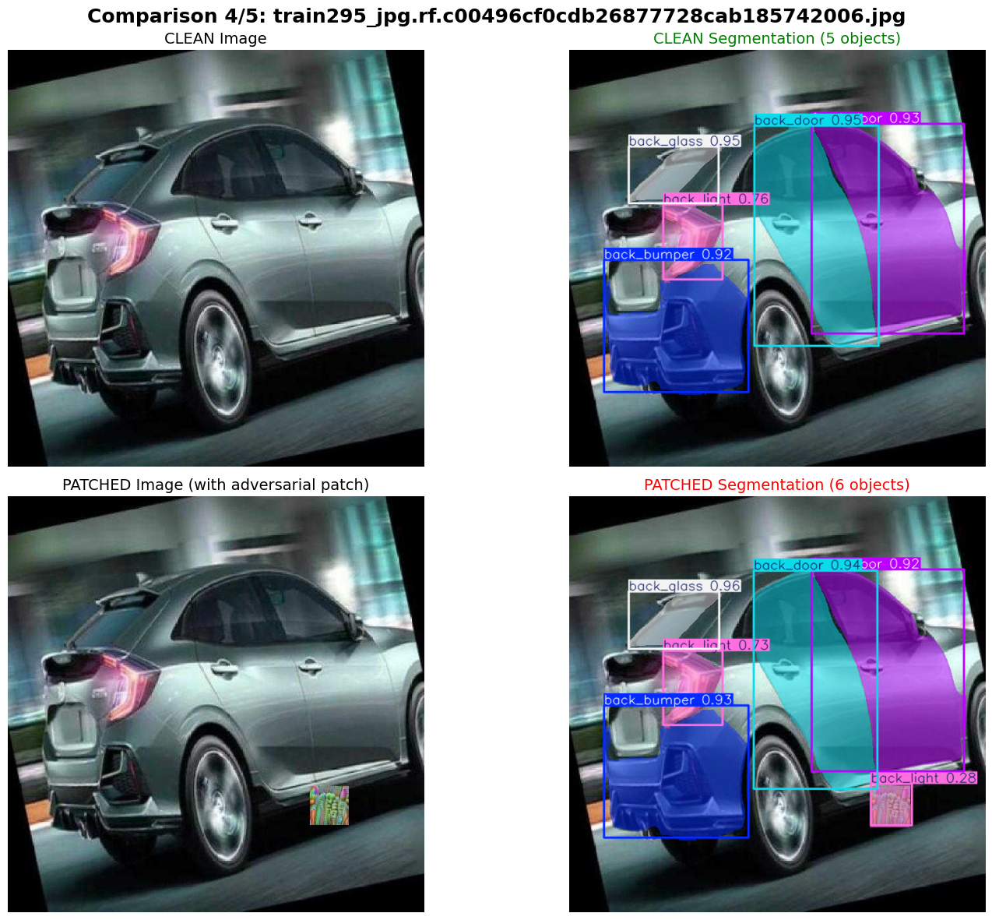

Slide 8
Considering only the patched images which were able to fool YOLOV8 as the dataset and tried segmenting them using YOLOV8

Slide 9
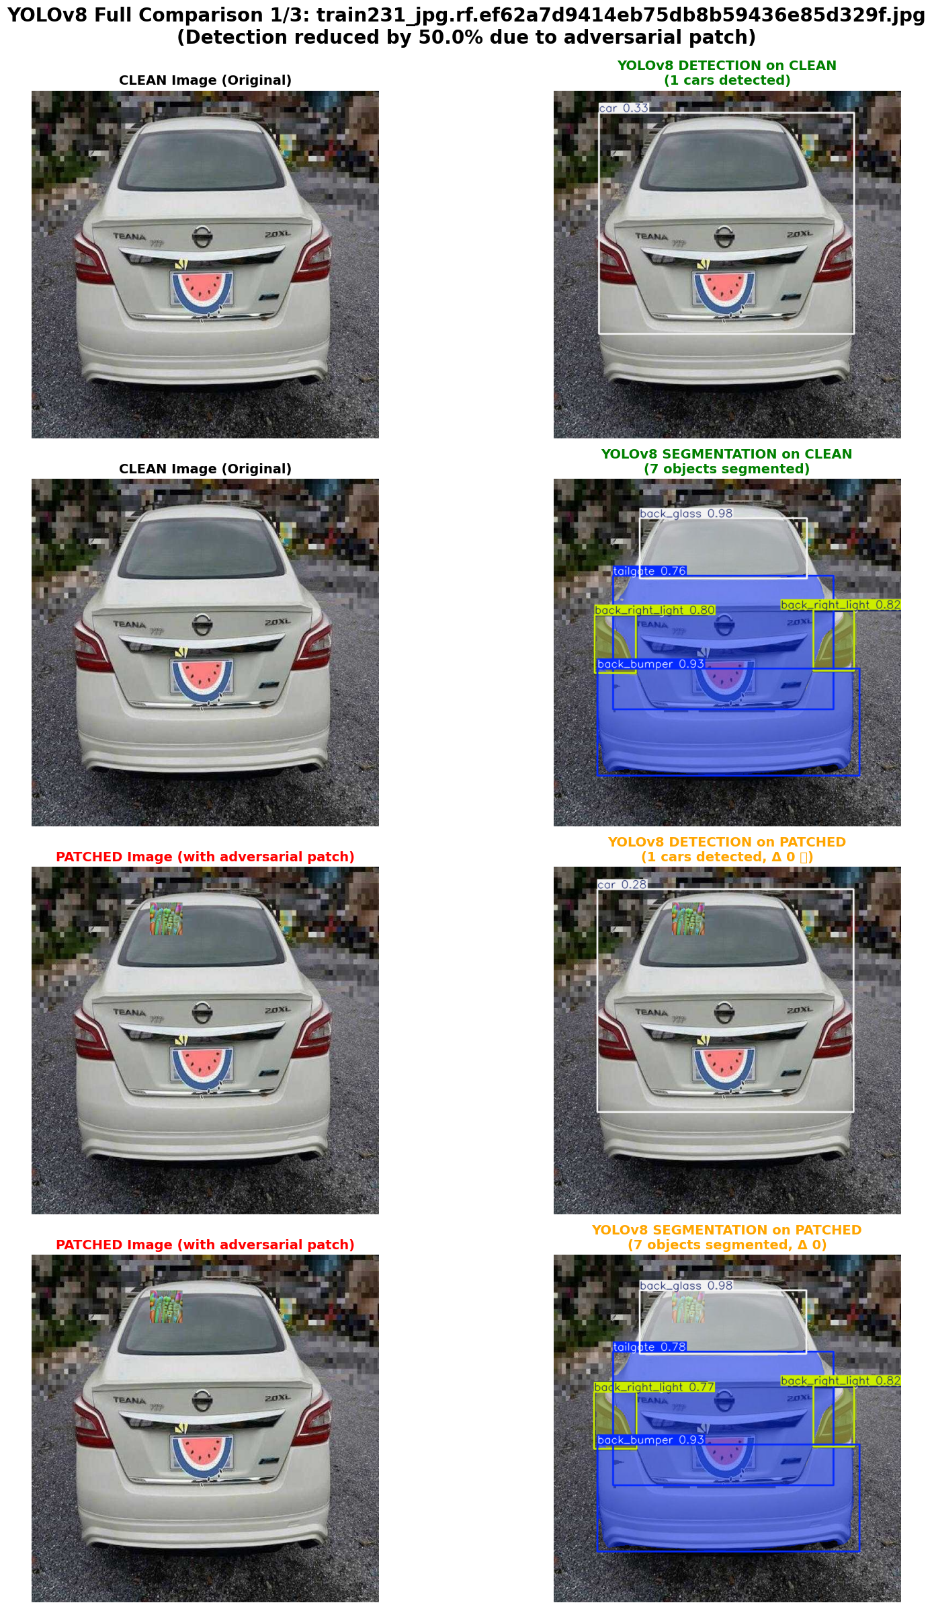
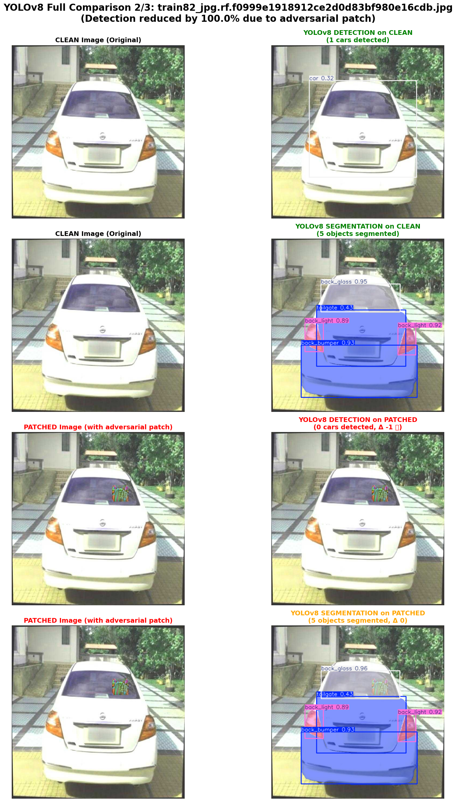
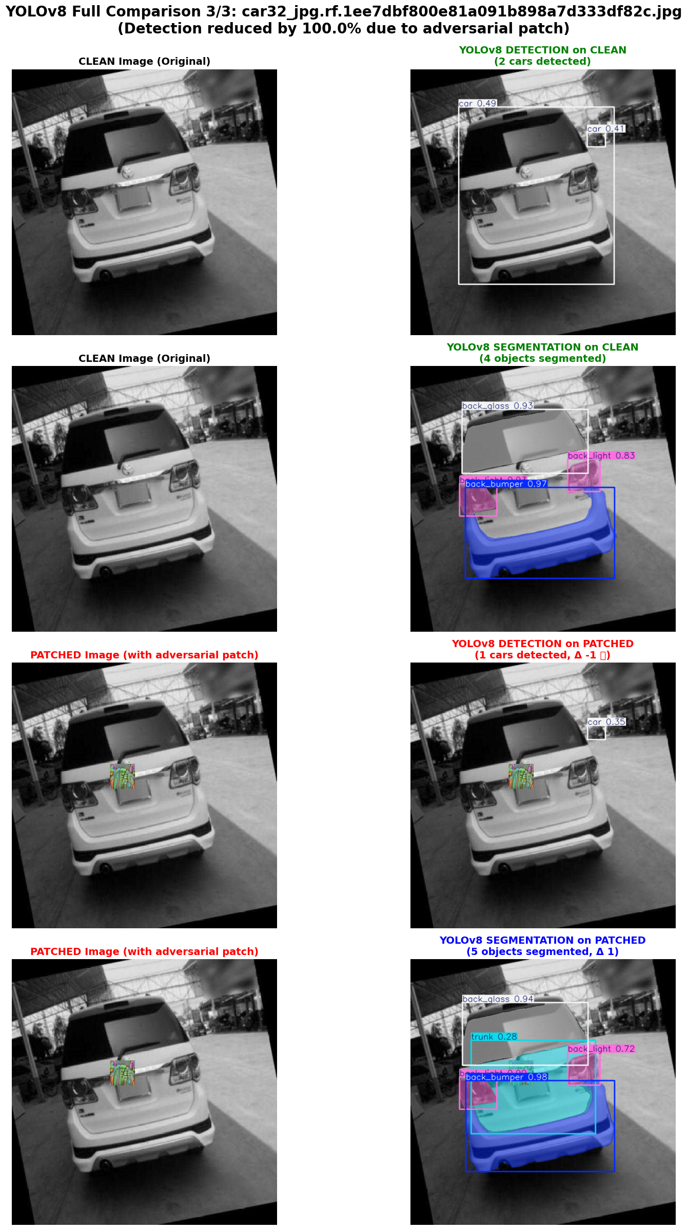

Slide 10
It can be said that the patch which fooled YOLOV8 from detecting cars in some of the images failed to fool segmentation model regardless of the YOLO version

